Slide 1
Modern TV Remote Smart Interface
Submitted by- Aman Singh (6303), Gyanish (6340), Rahul Ranjan (6324)

Slide 2

Project Overview
Mobile-friendly TV remote
Optimized for smartphones and tablets.
Built with HTML5, CSS3, JavaScript
No external libraries, lightweight design.
Features voice control, OTT app support
Hands-free operation and app integration.
This project aims to provide an intuitive, mobile-optimized TV remote interface combining traditional controls with modern voice and touch interaction. The focus was on accessibility, speed, and user comfort.

Slide 3

Challenges
Balancing Simplicity vs. Features
Minimal clutter while keeping powerful functions.
Ensuring Accessibility
Voice commands and haptic feedback for all users.
Mobile Responsiveness
Dynamic resizing and touch optimization.
Voice & Gesture Integration

Slide 4
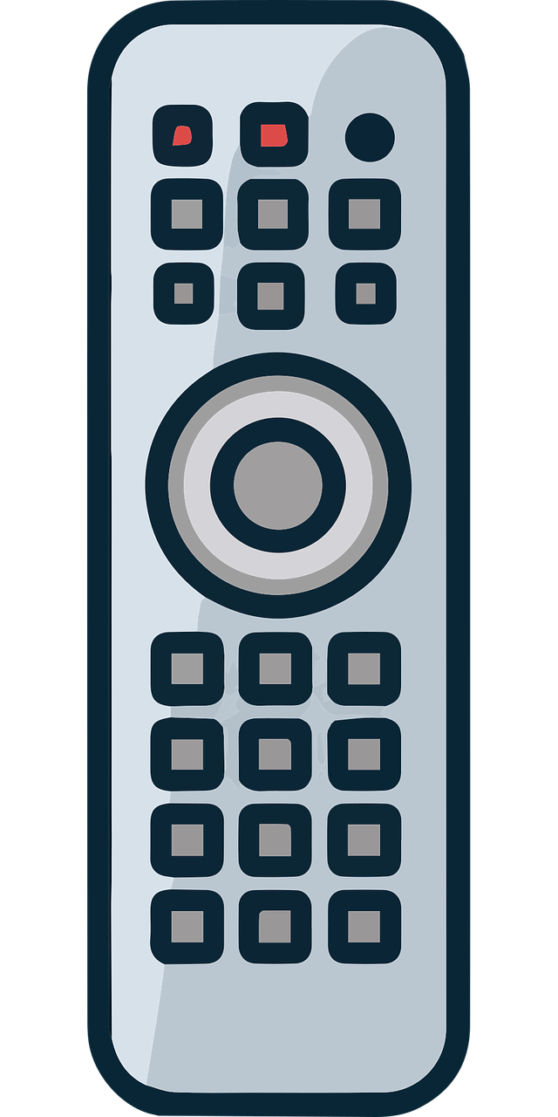
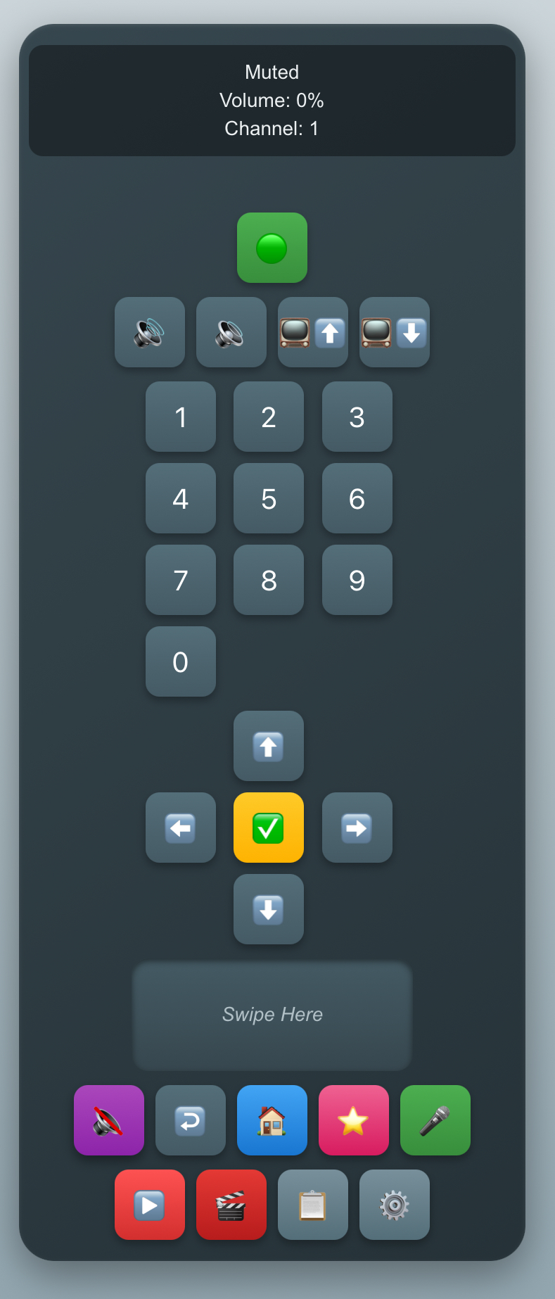
UI Screens
Main Remote Control
Power, volume, channel controls centralized.
OTT Control (YouTube, Netflix)
Favorites List Page
Quick access to favorite channels.
Settings Configuration Page
Adjust beep, vibration, theme.

Slide 5
Core Features
Power, Volume, Channel ControlS
Number Pad Input
Voice Command Support
Touchpad Swipe Gestures
OTT Platform Control
The smart remote interface focuses on providing all critical functionalities with simple taps, swipes, and voice commands, making the experience effortless and interactive.

Slide 6
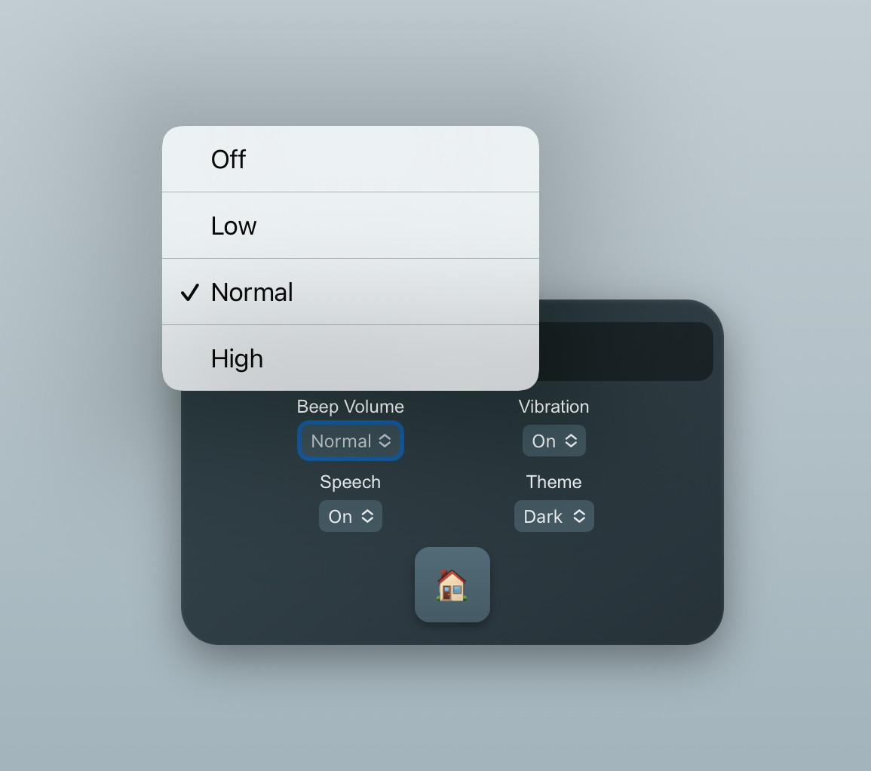
Accessibility Features
Voice Feedback (Speech Synthesis)
Confirms actions like 'Volume increased'.
Haptic Feedback (Vibration)
Audio Beeps
Subtle sound cues on interaction.
Mobile-Optimized Buttons
Larger, spaced buttons for easy tapping.

Slide 7
Technology Stack
HTML5, CSS3 (Flexbox, Grid, Media Queries)
Vanilla JavaScript (No libraries)
Web Speech API (Voice Recognition)
Voice input and feedback.
Touch Events API (Swipe Gestures)
Native swipe detection and actions.

Slide 8
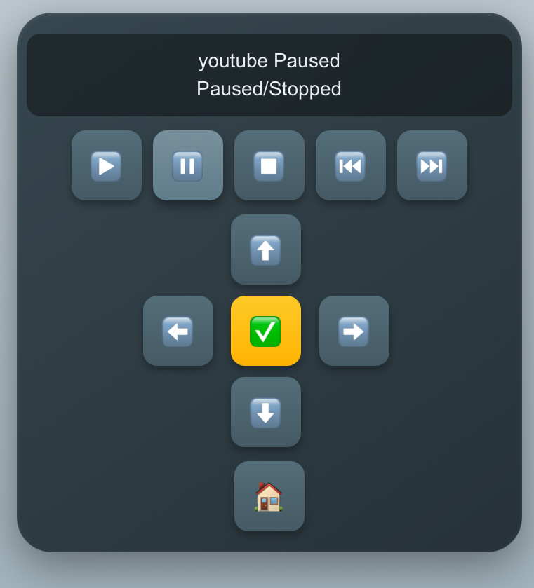
Modern Trends Implemented
Voice Recognition Commands
Personalized AI-like Interaction
Cross-Device (Touch + Voice) Support
OTT Service Integration
Instant access to YouTube, Netflix via remote.

Slide 9
Conclusion
Balanced Usability and Functionality
High Accessibility Features
Future Scope
IR/Bluetooth hardware integration, Smart TV linking.
This project shows that an intuitive TV remote UI can combine touch, voice, and traditional navigation methods to create an enhanced, accessible user experience. Future versions could integrate with actual TV devices via Bluetooth or Wi-Fi.

Slide 10
References
https://in.pinterest.com/kvnr/remote-ui-design/
https://en.wikipedia.org/wiki/Remote_control
https://www.youtube.com/watch?v=X1SNkEZW5h8
https://stackoverflow.com/questions/42882167/tv-remote-control-layout-with-flexbox
https://cpe-iitg.vlabs.ac.in/exp/prototyping-tv-remote/simulation/remote.html
https://github.com/denilsonsa/crx-ss-tv-remote/blob/master/tvremote.html

